Slide 1
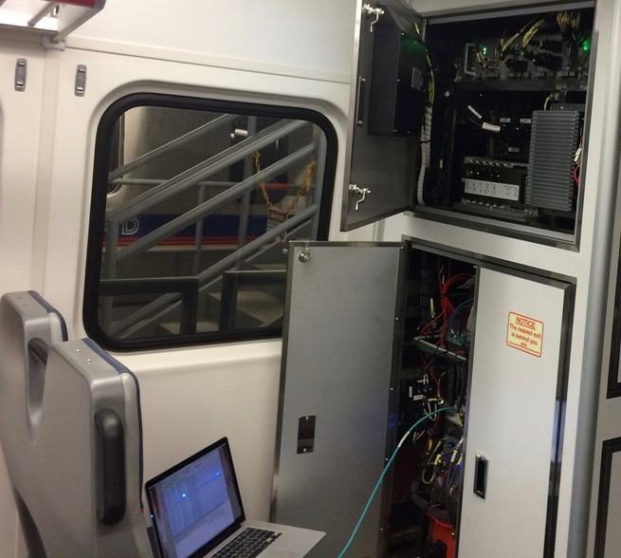
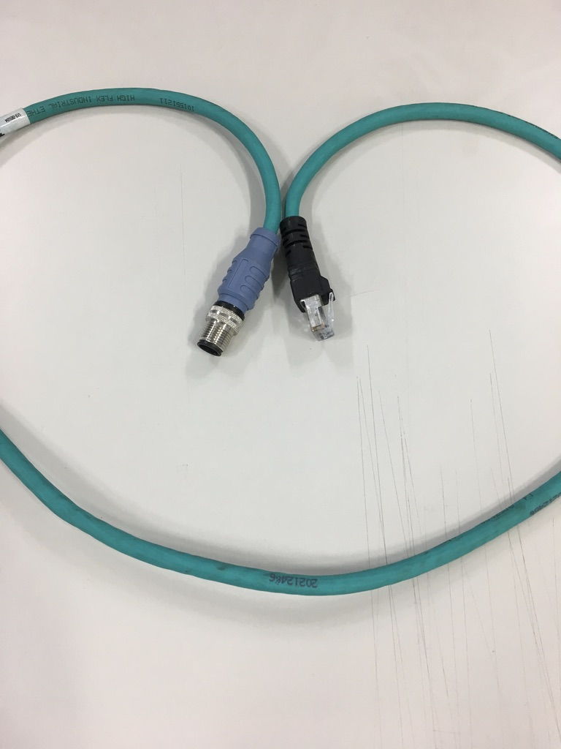
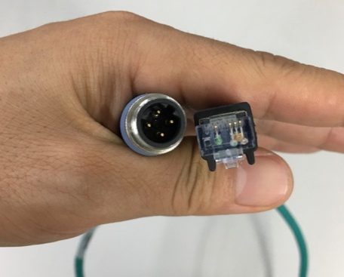
Moxa Switch hub
Ethernet for Laptop

Slide 2
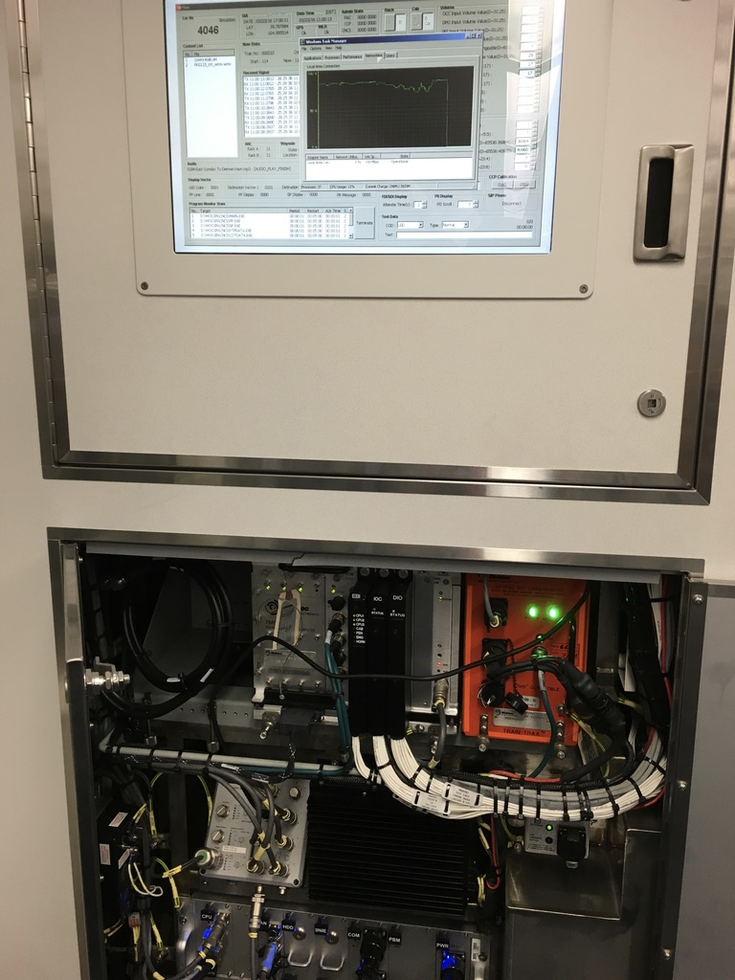
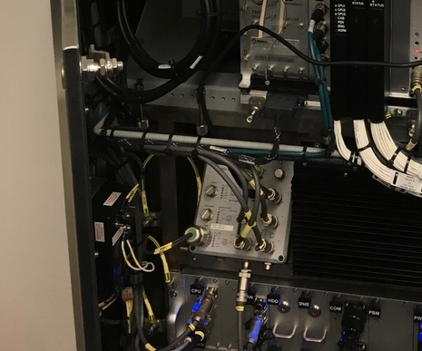
Moxa Switch hub connect laptop

Slide 3
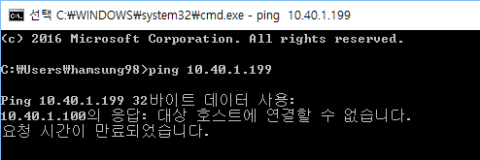
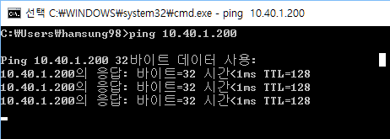
1. VOIP Connection Check
Connect cable to laptop on one side and Moxa Switch hub on the other
Change laptop IP address to match car number
Ex) 10.xx.yy.223(xx.yy is car number 40.15 for car 4015, the last digits 223 is for laptop)
3. Open Windows command window
4. Type “ping 10.xx.yy.199” and then Enter
5. Check ping test
199
199
199
199
199
Voip not connected
Voip connected
6. If VOIP passes the ping test then VOIP Local status is good

Slide 4
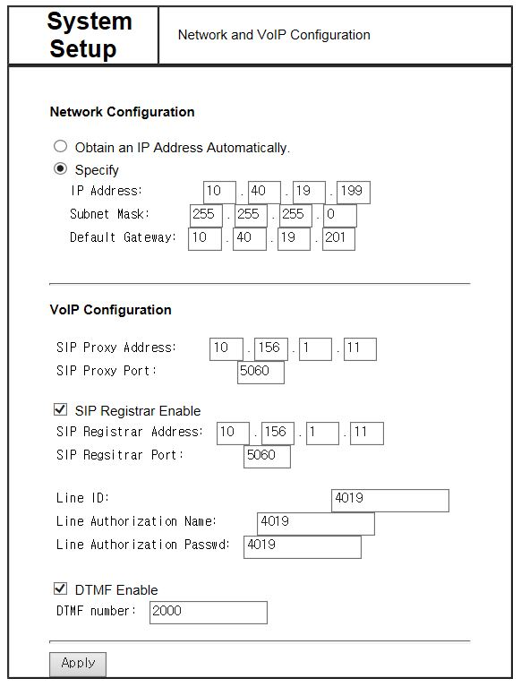
2. VOIP status check
Voip can only be accessed using Internet Explorer browser
In the Explorer address bar enter http://10.xx.yy.199
3. If what is shown looks the same as above then the VOIP setttings are good

Slide 5
3. CNCS connection check
Connect cable to laptop on one side and Moxa Switch hub on the other
Change laptop IP address to match car number
Ex) 10.xx.yy.223(xx.yy is car number 40.15 for car 4015, the last digits 223 is for laptop)
3. Open Windows command window
4. Type “ping 10.xx.yy.200” and then Enter
5. Check ping test
200
200
200
CNCS not connected
CNCS connected
6. If ping test shows CNCS is connected, then CNCS connection is good
7. Check CNCS’s network status and if the gateway is set as 10.xx.yy.201 then the settings are good

Slide 6
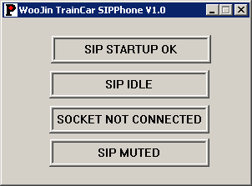
4. CNCS SIP Status Check
Connect keyboard to CNCS
Press Alt+Tab keys and check if the Woojin TrainCar SIPPhone V1.0 program is still running
3. If the above program is still running, then SIP is good

